Slide 1
Employee Data Analysis using Excel
STUDENT NAME:RAAHINA RASOOL.F
REGISTER NO:312209782,asunm1353312209782
DEPARTMENT:B.COM(computer applications)
COLLEGE: Anna Adarsh college for women

Slide 2
PROJECT TITLE
Employee Performance Analysis using Excel

Slide 3


AGENDA
Problem Statement
Project Overview
End Users
Our Solution and Proposition
Dataset Description
Modelling Approach
Results and Discussion
Conclusion
3/21/2024 Annual Review

Slide 4

PROBLEM STATEMENT
Employee Analytics allows us to take all these steps to improve an organization's operational efficiency with practical management strategies. This makes an organization efficient while being data-driven.

Slide 5

PROJECT OVERVIEW
Analyze Data in Excel empowers you to understand your data through natural language queries that allow you to ask questions about your data without having to write complicated formulas. In addition, Analyze Data provides high-level visual summaries, trends, and patterns.

Slide 6

WHO ARE THE END USERS?
Employee
Employer
HR
Manager
Director
Team leader

Slide 7

OUR SOLUTION AND ITS VALUE PROPOSITION
A value proposition is a core component of a modern, actionable data and analytics strategy. Most data and analytics strategies define goals and discuss a roadmap but lack an explicit description of their value proposition(s). However, data and analytics initiatives are not necessarily self-evident.

Slide 8
Dataset Description
Employee analytics can include valuable workforce metrics, such as employee attrition, benefits, and engagement statistics. And, each of these data points weaves the story that reveals the employee experience at your organization

Slide 9

THE "WOW" IN OUR SOLUTION
Its very easy to understand and deal with it...
3/21/2024 Annual Review

Slide 10
MODELLING
Data collection
1)downloaded in Kaggle
2)used edunet dashboard to download
Feature collection
1)highlighted
2)removed the blanks
Data cleaning
1)identified missing values
2)filtered the missing values
Performance level
1)used formula
2)identified
Summary
1)to deal with employee
2)easily the data can be taken
visualization
1)easily identified
2)easily accessed

Slide 11
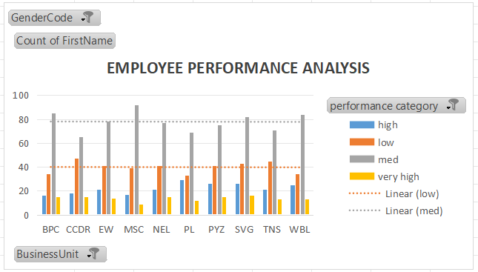
RESULTS

Slide 12
conclusion
Streamlined process
Excel can streamline the process of analyzing employee compensation data by eliminating manual calculations.
Powerful tool
Excel can be a powerful tool for HR to use to analyze data and develop insights.
Recognize patterns
Excel can help staff members recognize patterns and spot trends in data.
Draw conclusions
Excel can help staff members draw conclusions from data, which is an important part of problem-solving.
Analyze big datasets
Excel can be used to analyze large datasets to uncover patterns and trends.

